Slide 1
Bad Statistics

Slide 2
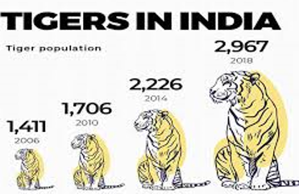
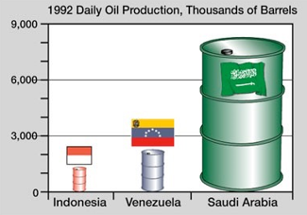
- pictograms are in 2-dimension
- increasing/reducing the area by a factor of 4
- making the increase/decrease seem much more dramatic.
Avoid pictograms!
Notes:
Because doctor pictogram is 2D, halving it, i.e. halving both dimensions (height and width), means reducing the area by a factor of 4, making the decrease seem much more dramatic.
Avoid pictograms!

Slide 3
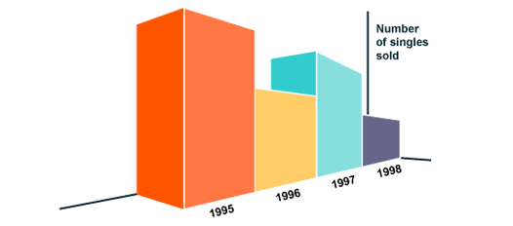
^{What is wrong with this graph?}

Slide 4
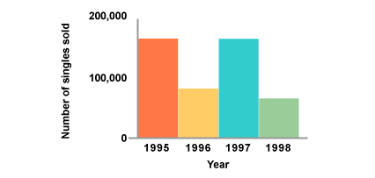
Avoid perspective (3D) bar charts - they are misleading

Slide 5
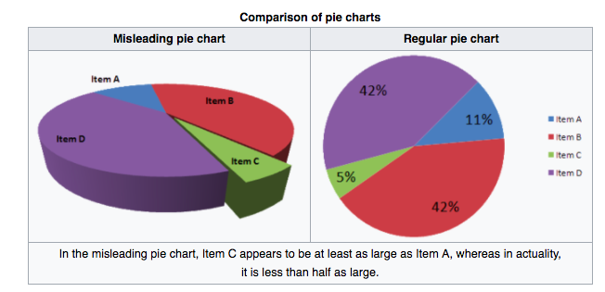
^{Same thing for pie charts}

Slide 6
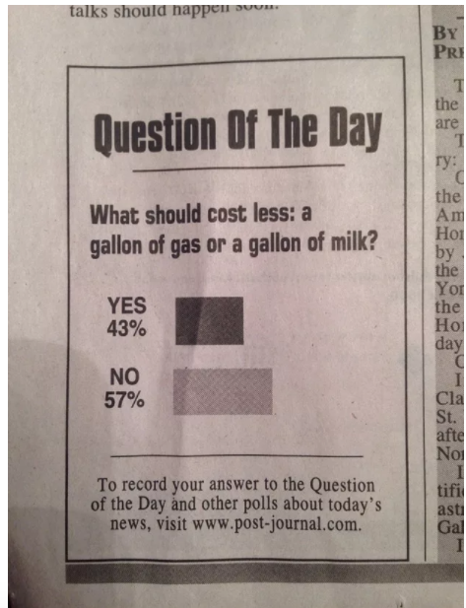
Bar graphs can be drawn vertically or horizontally.
But the labels should make sense!

Slide 7
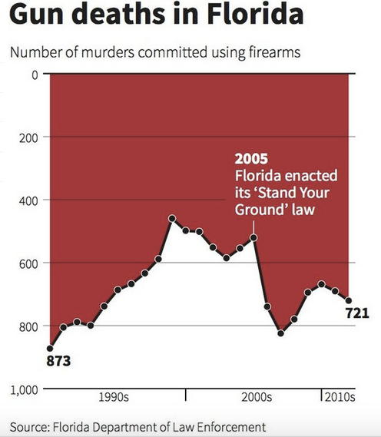
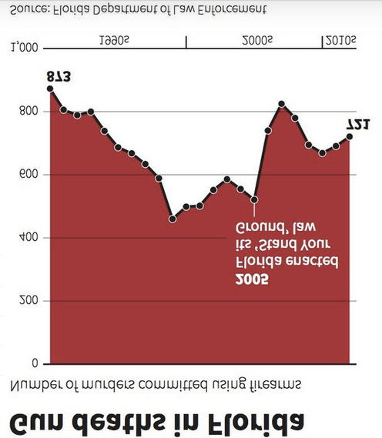
Fixed graph:
rotated 180º and mirrored
Original graph

Slide 8
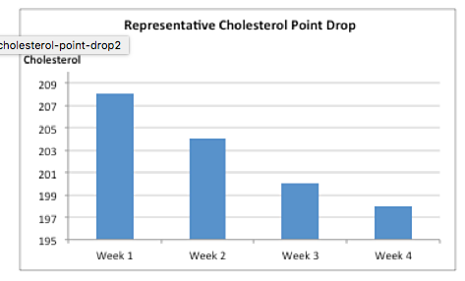
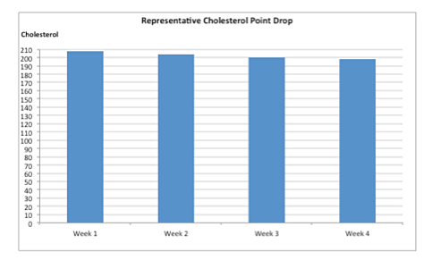
Bar charts - beware of vertical axis...

Slide 9
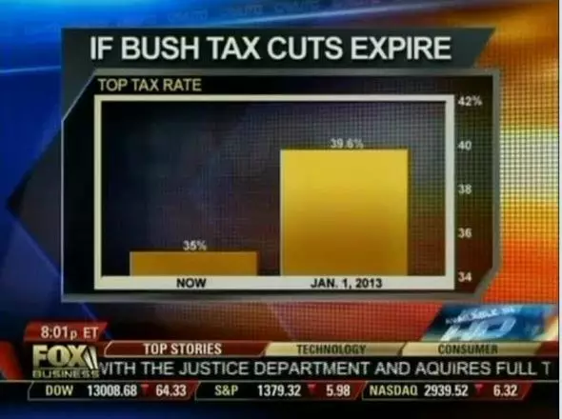
39.6% never looked so much larger than 35%

Slide 10
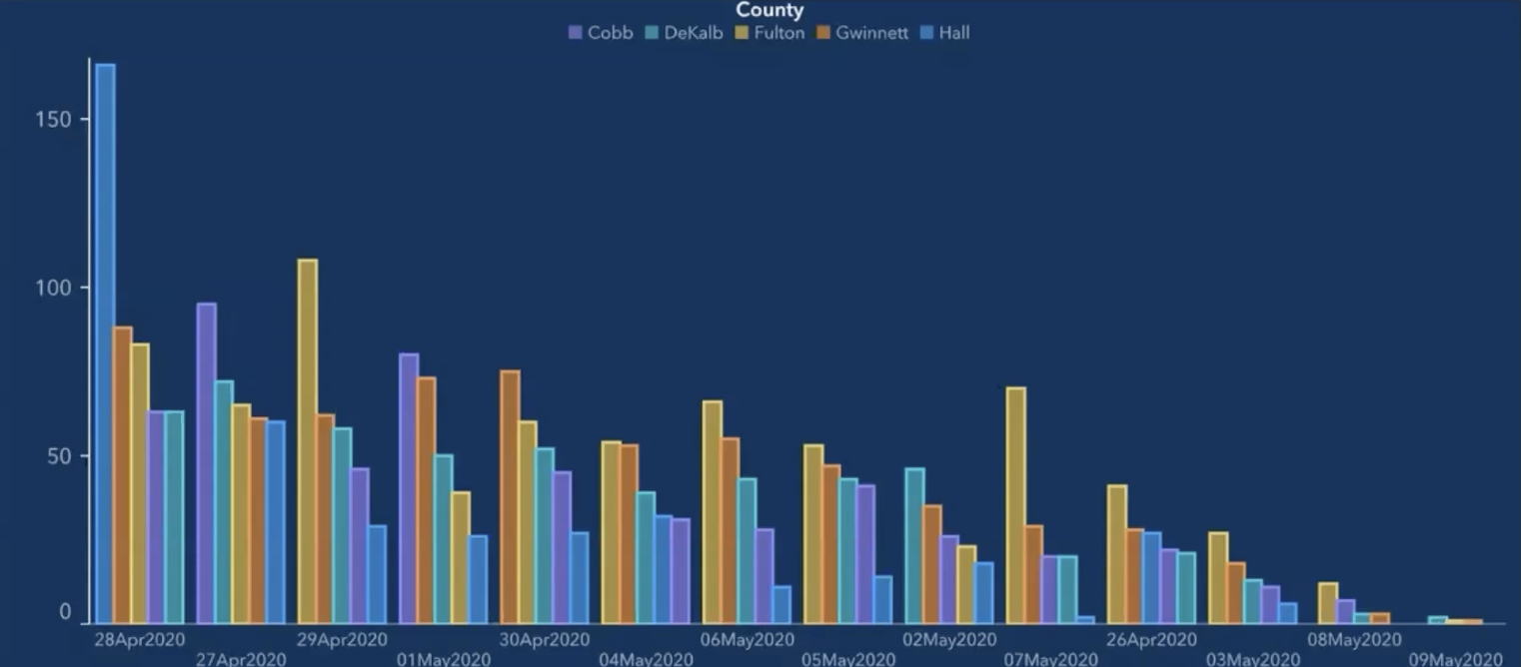
Look closely at the dates on the x-axis
Notes:
横轴不按顺序

Slide 11
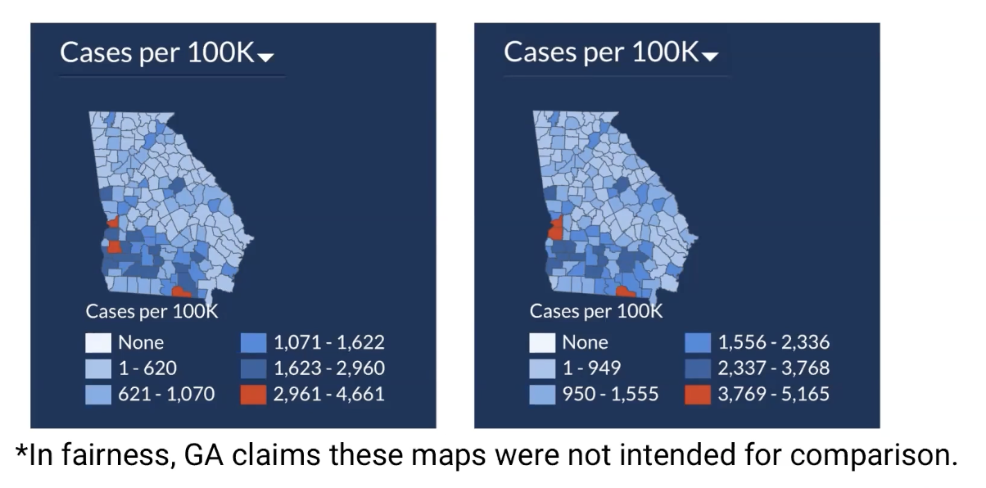
Notes:
the scale changes

Slide 12
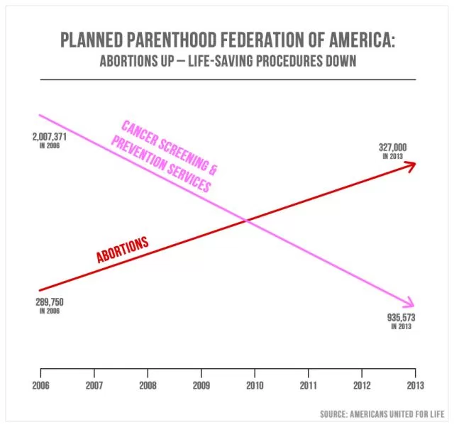
Notes:
What is on the y-axis? Nothing - so the placement of the lines is arbitrary.
To believe this chart as it’s presented is to believe 327,000 is larger than 935,573.

Slide 13
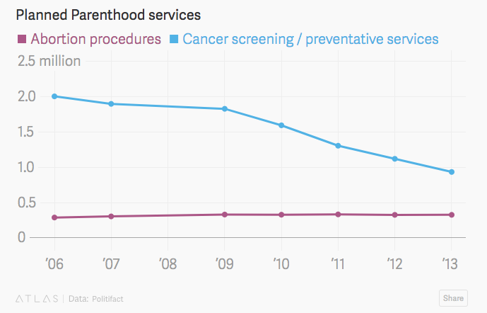
Same graph, on consistent vertical axis
Notes:
The number of cancer screenings and preventative services did go down.
But there are still far more of those procedures than there are abortions.

Slide 14

^{What is wrong with this graph?}
Notes:
First, it’s never a good idea to illustrate elements of a chart.
# books in each stack: 5, 5, 10, 14, 15, 16, 16
It’s not even the case that each extra book is an additional percent
Is this a bar graph or a time plot? If a bar graph, vertical axis should start at zero

Slide 15
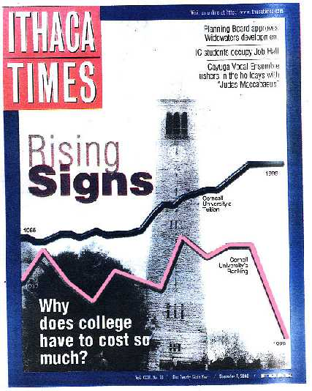
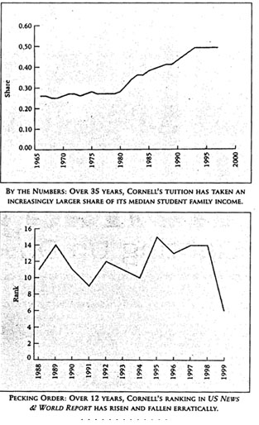
Cornell University Tuition vs Cornell University Ranking….
Notes:
Share is not the same as tuition - greater numbers of less wealthy going, so would take a greater share of median family income
Horizontal axes are not the same
What is on vertical axis on cover? Nothing! Two graphs just slapped on the page.
And…
Rank - going down, or…. going UP?

Slide 16
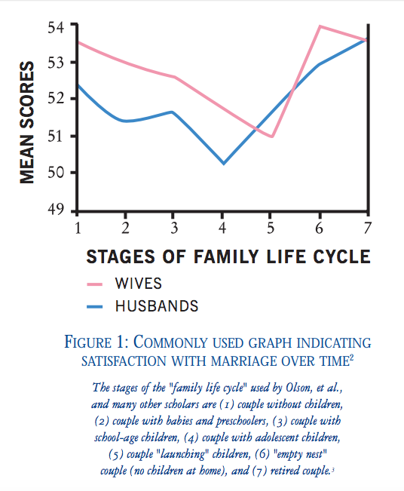
So can we conclude that children make a marriage unhappy?
Notes:
Horizontal axis not evenly spaced
What is score out of - 100?
How many people were in this study? 10? 1000?
“Satisfaction” not well define
Cross-sectional versus longitudinal
Observational study - confounding factors? Work responsibilities, etc.
Towards the end, who is missing? - Those that get divorced (leaving the remaining married people on average more happy - not because anyone necessarily got more happy, but because the unhappy people left the study)

Slide 17
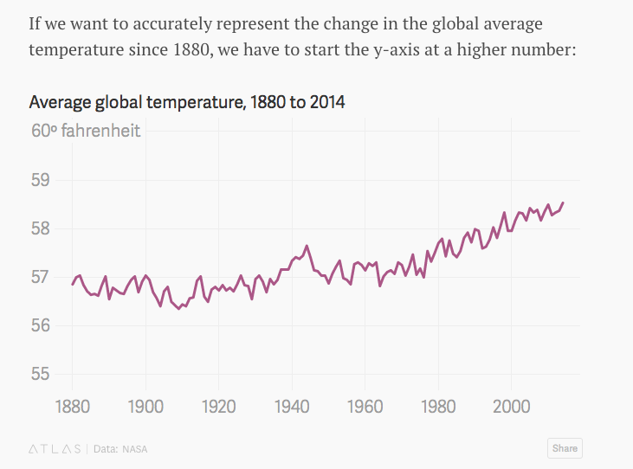
Scatter plot axes don’t need to start at 0!
Notes:
The designer of graph can zoom in or zoom out, stretch or shrink the vertical axis, as much as they want to communicate what they want...the point is that the READER must base their conclusion not on the visual impression of the graph, but from a close reading of the axes and an understanding of how big the change is in context.

